Slide 1
第2课 创建首个应用程序
使用Express VI创建一个项目以及一个采集、分析数据并显示结果的简单VI。
数据流
LabVIEW数据类型
编写、整理和组织VI的工具
创建一个简单VI

Slide 2
A. 数据流
认识程序框图上数据流的特点。

Slide 3

A. 数据流
数据流的重点知识
只有接收到全部输入数据后，节点才开始执行。
节点执行结束后，才向输出端提供数据。
Notes:
When a node executes, it produces output data and passes the data to the next node in the dataflow path.
The movement of data through the nodes determines the execution order of the VIs and functions on the block diagram.
LabVIEW does NOT use a control flow program execution model like Visual Basic, C++, JAVA, and most other text-based programming languages. In a control flow model, the sequential order of program elements determines the execution order of a program.

Slide 4
活动2-1
认识数据流
确定下列程序框图的数据流执行顺序。
Notes:
The diagrams and discussion questions for the next slides are also available in the student exercise manual.

Slide 5
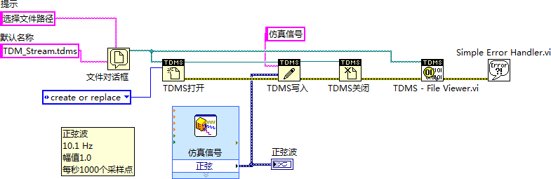
A. 数据流
数据流：示例A
Notes:
Use this diagram to discuss dataflow. Focus on the wiring dependencies and data flow between nodes. Students should not to be concerned with specific data types nor the functionality of actual nodes for this exercise.
Discussion areas:
Which node executes first? Last?
Is there any dependency between the File Dialog node and the Simulate Signal node?
Since the green path wire is wired from the File Dialog to the TDMS – File Viewer.vi, can the TDMS – File Viewer.vi execute before the TDMS Close functions? Point out that all the inputs have to be available before the node can execute.
Should a well-designed block diagram flow in a particular direction? Yes, a well-designed block diagram typically flows from left to right. This makes it easier to see the flow of data on the block diagram.

Slide 6
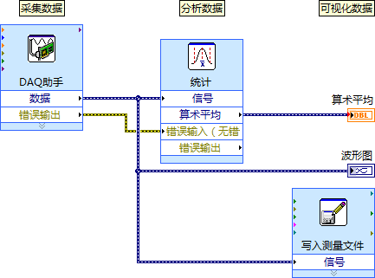
A. 数据流
数据流：示例B
?
Notes:
Either the Statistics Express VI or the Write to Measurement File Express VI executes last or they execute in parallel. The DAQ Assistant Express VI cannot execute last because both the Statistics Express VI and the Write to Measurement File Express VI are dependent on the data signal from the output of the DAQ Assistant Express VI. It is possible to have simultaneous operations.
You may want to open a VI and show students what is happening in this diagram using execution highlighting.

Slide 7
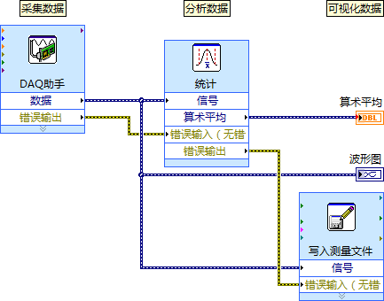
A. 数据流
数据流：范例C
?
Notes:
Now that there is a new yellow error wire, which express VI executes last?
The Write to Measurement File executes last because of dependencies on the DAQ Assistant and Statistics Express VIs.

Slide 8
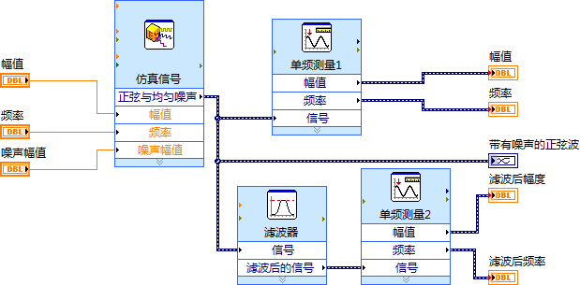
A. 数据流
数据流：示例D
?
Notes:
Either one of the Tone Measurement Express VIs can execute last. Even though the Tone Measurements 2 Express VI has an extra dependency on the Filter Express VI, the Filter Express VI might execute before the Tone Measurements 1 Express VI allowing the Tone Measurements 2 Express VI to execute before the Tone Measurements 1 Express VI.

Slide 9
B. LabVIEW数据类型
认识各数据类型并了解其同前面板对象的关系。
访问对象属性
布尔数据
数值数据表示法
字符串
枚举型
其他数据类型

Slide 10
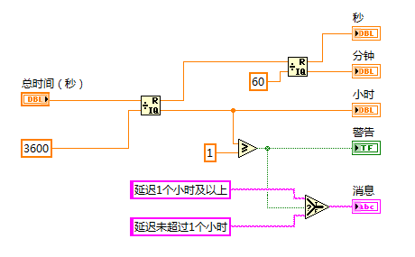
B. LabVIEW数据类型
接线端和LabVIEW数据类型
接线端可直观地反映数据类型的信息。
Notes:
Terminal colors, text, arrow direction, and border thickness all provide visual information about the terminal.
For example, Orange represents floating point numbers. DBL indicates a double-precision floating point number.
Terminals with thick borders with arrows on the right are control terminals. Terminals with thin borders with arrows on the left are indicator terminals.

Slide 11
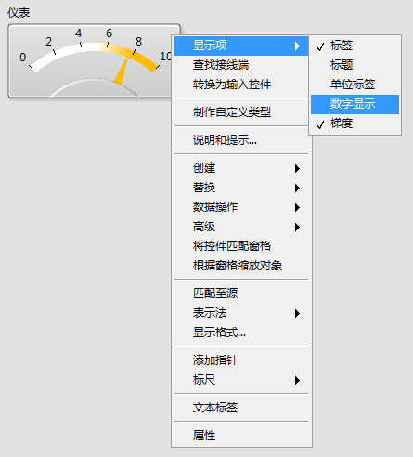
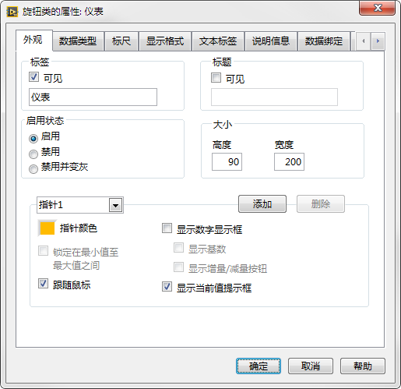
访问对象属性

Slide 12


B. LabVIEW数据类型
布尔数据
Notes:
Use Boolean controls and indicators to enter and display Boolean (TRUE/FALSE) values. For example, if you are monitoring the temperature of an experiment, you can place a Boolean warning light (LED) on the front panel to indicate when the temperature exceeds a certain level. To properly use Boolean values they should only be used to represent items that can have only two values: yes/no, true/false, on/off, etc
Instructor: Point out the difference between the label name and Boolean text. Show how the label matches the block diagram terminal label. Boolean text is cosmetic and appears only on the front panel.

Slide 13
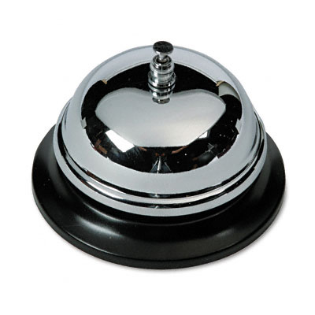


布尔控件的机械动作
Notes:
Point out that in everyday life we interface with many Boolean switches and buttons. These switches and buttons have different mechanical behaviors.
Light switches change state when the switch is flipped. The state stays the same until you flip the switch again.
Buzzers and door bells change state on a button press. They change back when the button is released.
Mouse clicks and keyboard presses have a latch behavior. They change state on a button release. Furthermore, the key press or mouse click only takes effect when read by the system. When your computer system is sluggish, we sometimes see a delay in processing a mouse click or key press.

Slide 14

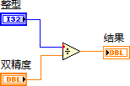

数值数据表示法
Notes:
Various data type representations:
Floating-point
Unsigned integers
Signed integers
Conversion/Coercion
For this slide, talk about the difference between unsigned integers, signed integers, and floating point.
Integers represent whole numbers.
Unsigned integers are non-negative values.
Signed integers can be positive, negative, or zero.
Students learned about the numeric, Boolean and string data types in Lesson 1. Now, they learn about implementing these data types, such as representation, Boolean action, and string display type. They also learn a couple new data types: Enum and dynamic.

Slide 15
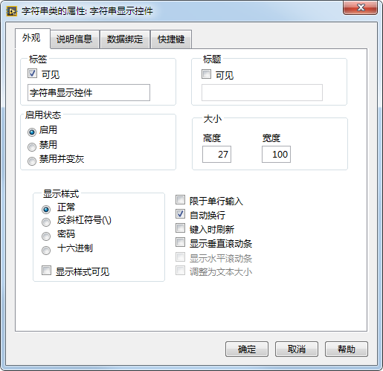

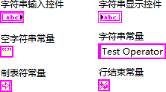
B. LabVIEW数据类型
字符串
Notes:
Uses for strings:
Creating simple text messages.
Controlling instruments by sending text commands to the instrument and returning data values in the form of either ASCII or binary strings which you then convert to numeric values.
Storing numeric data to disk. To store numeric data in an ASCII file, you must first convert numeric data to strings before writing the data to a disk file.
Instructing or prompting the user with dialog boxes.

Slide 16
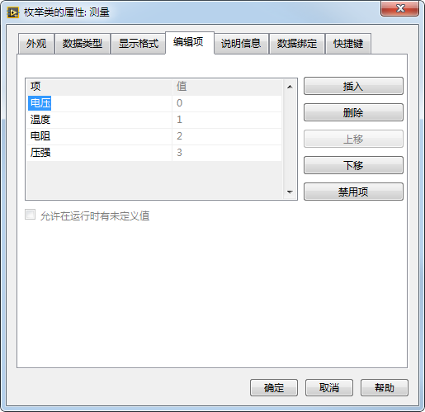

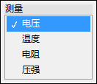
枚举
Notes:
Enums are useful because they make strings equivalent to numbers, and it is easier to manipulate numbers than strings on the block diagram.
Point out that the data type of the enum terminal is blue, showing that the enum is passing an integer value.

Slide 17
B. LabVIEW数据类型
其他数据类型
类型 | 接线端 | 说明
动态 |  | 保存由Express VI产生或采集的信息
路径 |  | 保存文件或路径的位置
波形 |  | 包含波形的数据、起始时间和时间间隔(△t)
Notes:
Ask students how a Path data type might differ from a String data type?
Although it is easy to convert a Path to a String, it is best to use a Path data type when working with a location of a file or directory. Using the Path data type, LabVIEW can handle the folder specifiers (for example, a backslash on Windows).

Slide 18
C. 编写、整理和组织VI的工具
认识使前面板和程序框图整齐易读及给VI添加说明信息的工具。
编程工具
连线技巧
使代码清晰易懂

Slide 19

编程工具
自动选择工具
工具选板
Notes:
By default, LabVIEW selects tools for you based on the context of your cursor. If you need more control over which tool is selected, use the Tools palette to select a specific tool to operate or to modify front panel and block diagram objects. Select View»Tools Palette to display the Tools palette.
Demonstrate the difference between automatic tool selection and specific tool selection. Also show how to use the Tools palette for coloring objects.

Slide 20
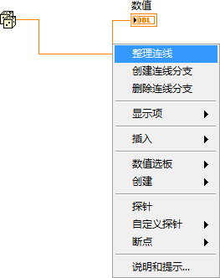
连线技巧

Slide 21
练习2-1
选择工具
熟悉LabVIEW中的自动选择工具和工具选板。
Notes:
This is the first exercise spent entirely in LabVIEW. They will experience resizing, moving, selecting objects, and wiring. Spend extra time here if necessary until students are comfortable with the automatic tool selection.

Slide 22
练习2-1
选择工具
如何启用“自动选择工具”选项？
Notes:
How do you enable automatic tool selection?
Make sure that the Automatic Tool Selection button is enabled on the Tools palette. To view the Tools palette, you can either select View»Tools Palette or hold the <Shift> key while right-clicking the front panel.

Slide 23
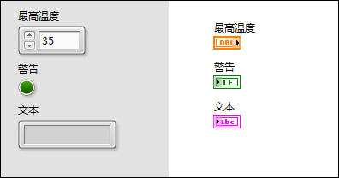
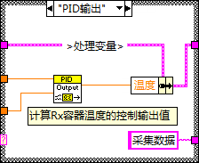
使代码清晰易懂
Notes:
Front panel controls and indicators create terminals on the block diagram. The front panel is the user interface. Usually you start a VI with inputs and outputs on the front panel. The block diagram is the programming behind the user interface. After you build the front panel, you add code on the block diagram to control the front panel objects.
The labels of the front panel objects become the identifying labels for the terminals on the block diagram.
You can also set default values for controls and indicators.

Slide 24
D. 创建简单VI
认识Express VI并学会合理运用。

Slide 25
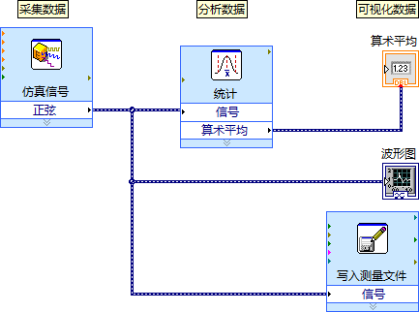
D. 创建简单VI
创建一个简单VI

Slide 26

活动2-2
简单AAV VI的程序架构
参考学员指南回答简单AAV VI编程构架的问题，并分组进行讨论。

Slide 27
练习2-2
简单“采集-分析-显示”VI
创建一个简单VI，使VI采集数据、分析数据并显示结果。
Notes:
Students that do not have DAQ hardware can use the Simulate Signal Express VI to generate a waveform.
The instructions in the Exercise manual guide students through the process of creating the VI

Slide 28
练习2-2
简单“采集-分析-显示”VI
如何确定生成文本文件的路径？
Notes:
What is the file path of the generated text file?
The file path of the text file is configured in the Write To Measurement File Express VI.
Double-click the Write To Measurement File Express VI to find the file path of the text file.

Slide 29
活动2-3
课程回顾
参考学员指南回答本课所学内容的相关问题，并分组进行讨论。

Slide 30

课程回顾
哪个函数最先执行：加还是减？
加
减
未知
Notes:
The answer is a.

Slide 31
课程回顾
哪个函数最先执行：加还是减？
加
减
未知

Slide 32

课程回顾
哪个函数先执行：正弦还是除？
正弦
除
未知
Notes:
The answer is b.

Slide 33
课程回顾
哪个函数先执行：正弦还是除？
正弦波
除
未知

Slide 34
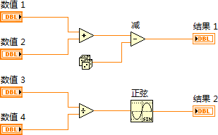
课程回顾
下列哪个函数最先执行：随机数、加或除？
随机数
除
加
未知
Notes:
The answer is d.

Slide 35
课程回顾
下列哪个函数最先执行：随机数、加或除？
随机数
除
加
未知

Slide 36
课程回顾
下列哪个函数最后执行：随机数、减或加？
随机数
减
加
未知
Notes:
The answer is b.

Slide 37
课程回顾
下列哪个函数最后执行：随机数、减或加？
随机数
减
加
未知

Slide 38
课程回顾
如函数的输入端标记有一个红点（强制转换点），该点表明以下哪个信息？
数据被传输至结构
输入端未连线
连线断开
传输至节点的值被转换为其他表示法
Notes:
Answer is d.

Slide 39
课程回顾
如函数的输入端标记有一个红点（强制转换点），该点表明以下哪个信息？
数据被传输至结构
输入端未连线
连线断开
传输至节点的值被转换为其他表示法

Slide 40
课程回顾
哪一种机械动作会在按下布尔控件时将布尔值由“假”转换为“真”，且松开控件后，直至LabVIEW读取该值前均保持“真”值？
保持转换直到释放
释放时转换
单击时触发
释放时触发
Notes:
Answer is c.

Slide 41
课程回顾
哪一种机械动作会在按下布尔控件时将布尔值由“假”转换为“真”，且松开控件后，直至LabVIEW读取该值前均保持“真”值？
保持转换直到释放
释放时转换
单击时触发
释放时触发

